Slide 1
ATDD, BDD, Story Testing, & Specification By Example
Adding Examples to Acceptance Criteria
Andrew Fuqua
678-763-8025
andrew@leadingagile.com
@andrewmfuqua
in/andrewfuqua
Notes:
1/2015 AF@LZ
3/2015 AF@DevNexus

Slide 2
Why do we have defects?
Misunderstanding
Code
Other technical
Requirements

Slide 3
How can we reduce defects due to misunderstanding code & technology?
Pair program
Use SOLID design principles
TDD

Slide 4
Does misunderstanding cause problems other than defects?
Tension
Mistrust
People assume the worst in others
Lazy
Dumb
Bad intentions

Slide 5
How can we prevent misunderstanding?
Or, how can we gain shared understanding?
Through Examples!
Notes:
If everyone gets at least an increased awareness to the examples around them AND STARTS RECORDING THEM, then this is time well spent.

Slide 6
We Already Use Examples:
Customer and BA
QA
Dev
The problem is, we use different examples!
Notes:
Customer talks to PO or BA and likely uses examples. BA/PO converts that to an abstract requirement and throws the example away.
QA has examples in test cases, but doesn’t share them with Dev or verify them with the customer. (And if they are willing to, it’s likely too late or not in a digestible form.)
Dev invents edge case examples, codes them, then throws the example away.

Slide 7
Acceptance Test Driven Development (ATDD) Cycle
Discuss
Distill
story
Red
Green
Clean
TDD
@Test
public void testTsd() {
int expected = Asdf.run();
assertEqual(expected,actual);
}
@Test
public void testTwo() {
Demo (Explore)
Develop
Adapted from James Shore & Melnick, Marick, Hendrickson
Notes:
Discuss – WITH EVERYONE: PO/BA, QA, Devs…. Whole team.

Slide 8
Discuss
Users are required to use secure passwords
Notes:
Suppose I have this story. What questions might you have for your PO/BA for this story?
WHICH users? (Is it the same for users with low permissions as for those (admins) with high permissions? Is it the same for users of our system as for logins to the user community forums?)
WHAT does SECURE mean? Length restrictions? Max or just min? Special chars? Which ones? What about easy to guess (“P@ssw0rd”) (dictionary attacks)?
WHEN exactly? When they create an account? What about existing accounts? Must they change their pw on next login if it isn’t secure?
WHAT ERROR MESSAGE should we give?
Any other actions on an error?
I would come up with acceptance criteria….

Slide 9
Discuss
Users are required to use secure passwords
Verify length > 7
Verify at least 1 lower case, 1 upper case, & 1 number
Verify at least 1 symbol
Verify no special characters
Verify no forbidden (easy) passwords
Could I go code this now?
Notes:
I might have acceptance criteria like this (plus some more about error messages/handling).
(SHOW OF HANDS – doing this? Have no a/c?)
“Verify That…” is the minimal recommended approach for acceptance criteria.
At this point, I could end planning and go code this (i.e. before getting examples). True? True. I COULD, but it’d be better to get examples for each part of the biz rule….

Slide 10
Test Scripts for Acceptance Criteria?
Scripts are about ‘how’
The ‘why’ is forgotten or hidden
‘how’ changes more often than the biz rules
Notes:
NO! Don’t put test steps or test scripts in acceptance criteria.
“Verify That…” is the minimal recommended approach for acceptance criteria.
Examples or Gherkin is even better.

Slide 11
Discuss
Examples:
Abcd3fg! Too easy, sequence, starts with
uppercase and ends in punctuation
G7A9*&GK no lower case
a7a9*&gk no upper case
A&A%*&gk no number
pA55w0rd. easy to guess
d9G*ga(r only certain symbols allowed
d9G*ga, too short
d9G*ga,r good
G9d*ga,r good
G9~`!@#$%^&*a good
Do I have an example for each part of the biz rule?
Notes:
Write down all the examples.
During the DISCUSS phase, get more than you need. We’ll DISTILL them next.
Notice that we invented a couple more biz rules when writing down these examples: sequences aren’t allowed, and it’s not okay if the only upper case is the 1st character if the only punctuation is also the last character.

Slide 12
Acceptance Test Driven Development (ATDD) Cycle
Discuss
Distill
story
Red
Green
Clean
TDD
@Test
public void testTsd() {
int expected = Asdf.run();
assertEqual(expected,actual);
}
@Test
public void testTwo() {{
Demo (Explore)
Develop
Adapted from James Shore & Melnick, Marick, Hendrickson

Slide 13
Acceptance Test Driven Development (ATDD) Cycle
Distill
Reduce to bare minimum
1 per equivalence class
Boundary conditions (edge cases)
Normal use
Abnormal but reasonable use
Abnormal and unreasonable use
Notes:
ASK: Why reduce? Why might that be good?
Answer:
- Too many examples makes it hard to read, hard to digest
- And makes it run slow when automated

Slide 14
Acceptance Test Driven Development (ATDD) Cycle
Distill
Ubiquitous language
The language of the business
Tables
Domain Specific Language (DSL)
Avoid programmer jargon
Use Domain Driven Design
(Eric Evans)
Notes:
Build up a common, rigorous language between development and users.
How? By paying attention to the language, the lingo. Agree to what words mean. Maybe have a dictionary of terms. Avoid loose synonyms.
Automation will force the issue, will make you reuse common phrases.

Slide 15
Examples with Gherkin
Distill
Scenario: Free Popcorn Tuesday
Given it is Tuesday
When I buy at least 1 movie ticket
Then I should get a coupon for a free small popcorn.
Given I have ordered a small popcorn
When I hand over a Free Popcorn coupon
Then the price of the popcorn should be $0.
Notes:
Cucumber, CukeForNuke, SpecFlow, et. al.
(Given When Then is like Arrange Act Assert)

Slide 16
Sample Feature in Gherkin
Distill
Feature : As Fred (the bookseller) I want to login to the Bookseller pages for my profile so that I can add books to my books for sale list.
Scenario: correct credentials
Given the Bookseller login is activated,
When Fred supplies the correct credentials
and selects the login option
Then he is authenticated on the system
and the Bookseller page is presented
Scenario: incorrect credentials
Given the Bookseller login is activated,
When Fred supplies the incorrect credentials
and selects the login option
Then he is not authenticated on the system
and the Login Error is presented
Notes:
Note that biz people can read and understand these. AND they are executable.

Slide 17
What is Gherkin?
Distill
A business readable domain specific language that lets you describe software’s behavior without detailing how that behavior is implemented
Serves two purposes:
documentation
automated tests
The language that Cucumber understands
Cucumber is a BDD testing tool
Notes:
Cucumber can auto generate the test stubs that verify acceptance criteria have been met.
BDD/ATDD helps us identify MMF and additional scenarios early in the process, because of the rigor of the process, forcing us to think through the scenarios.

Slide 18
Examples with Tables
Distill
|eg.Division|
|numerator|denominator|quotient?|
|10 |2 |5 |
|12.6 |3 |4.2 |
|100 |4 |33 |
|Query: Users in the System |
|user name |role |user state |
|Tim Tester |Tester |active |
|Paul Programmer |Programmer |active |
|Petra PjM |Project Manager |active |
Adapted from www.fitnesse.org & ATDD By Example
Notes:
Tables are great for I/O mapping (such as the 1st example above), queries (2nd example above) , actions (script tables)
SUPPORTED BY MANY TOOLS:
Wiki / FIT / Fitnesse.org
Robot Framework
Concordian
Cucumber

Slide 19
Gherkin Tables
Distill
Scenario Outline: Withdraw fixed amount
Given I have <Balance> in my account
When I choose to withdraw <Withdrawal>
Then I should <Outcome>
And the balance of my account should be <Remaining>
Examples:
| Balance | Withdrawal | Remaining | Outcome |
| $500 | $50 | $450 | $50 cash |
| $500 | $100 | $400 | $100 cash |
| $500 | $200 | $300 | $200 cash |
| $100 | $200 | $100 | an error message |
Adapted from The Cucumber Book, Wynne/Hellesøy
Notes:
COOL! Gherkin also supports tables of examples! Templates even!

Slide 20
Usability Examples
Ask a UI Designer to show you a page he likes
Notes:
It might not be automatable, but there is value in the example – value in the communication.

Slide 21
Who and When?
Distill
Product Owner Team members write examples (tables or Gherkin)
Including PO, BA, QA, Dev
Cognitive Diversity
Everyone can read them
Don’t let QA or Dev own this by themselves
Written during backlog grooming
Updated at sprint planning and beyond
Notes:
If you let QA or Dev own this by themselves, they will use their special tool or IDE that only they know how to use or have a license for. The scenarios will be hidden from others. Others won’t be able to read them, use them, edit them or participate in the process and you’ll be missing out on the value of this whole thing – shared understanding.
We want “the business” to own and edit the specs. Use wiki, html, text.
BONUS: ask if ‘grooming’ is a ‘meeting’. Trick question. NO, it’s not exclusively a meeting. Lots of grooming can happen by the PO Team and even Whole Team members individually, or in pairs, or in small group workshops. The point is: don’t think you have to call a meeting for any grooming to get done, and that it only happens there. Take ownership of grooming, individually. Come together and review each other’s changes if that helps. Walk through a batch of stories for understanding. But don’t wait for a meeting to groom.

Slide 22
Activity
Write some Gherkin
Positive case
Negative case
Write some table-based examples
Notes:
[Here’s an optional but recommended activity to do. This would be a good place to do it except you’ll need to leave about half an hour to do the remaining slides, PLUS a few minutes for questions and to debrief and give the audience instructions on specifically what is expected of them going forward, which could vary by company, and maybe by team.]
[If I have allotted 2 hours for this workshop and can get to this point in 45 minutes, I’ll have 45 minutes for this activity including debrief. An hour is more likely… you always lose 5 minutes at the start waiting for people and engaging the audience well takes some time. It took me an hour to get to this point at LZ. That left 20 minutes for the exercise and 10 minutes for people to share their work and debrief. Which left 20 minutes for the remaining slides (which wasn’t enough – skipped a lot) and 10 minutes to debrief and give marching orders.]

Slide 23
Automation?
Distill
Yes:
Executable specifications rock!
Or no:
Value in collaboration & understanding
Living Specification
Self explanatory
Notes:
Automation is awesome and recommended, but not necessary to get the value out of this practice.

Slide 24
It’s not about testing
Notes:
Just to be clear ATDD isn’t about testing. (Funny name for it then, no?)
It’s about COMMUNICATING.
And it’s not about developing automated tests. Automating the examples are great, but they are not mandatory.
That said, let me talk for a little while about automating.

Slide 25
Acceptance Test Driven Development (ATDD) Cycle
Guides Requirements
Discuss
Distill
story
UAT isn’t done until the END
Guides Design
Red
Green
Clean
TDD
@Test
public void testTsd() {
int expected = Asdf.run();
assertEqual(expected,actual);
}
@Test
public void testTwo() {{
Demo
Develop
Adapted from James Shore & Melnick, Marick, Hendrickson
Notes:
ATDD is done BEFORE programming.
TDD is done DURING programming.
UAT is done at the END.

Slide 26
Acceptance Test Driven Development (ATDD) Cycle
new specs fail in CI until the story is done
Discuss
Distill
story
unit tests in CI always pass
Red
Green
Clean
TDD
@Test
public void testTsd() {
int expected = Asdf.run();
assertEqual(expected,actual);
}
@Test
public void testTwo() {{
Demo (Explore)
Develop
Adapted from James Shore & Melnick, Marick, Hendrickson
Notes:
It can take days to make a new “spec” pass. We check in the new specs when we start working on a story. It will fail (for days) (and is expected to) until the story is done.
Unit Tests, however, must NEVER FAIL in the Continuous Integration server. They are expected to pass always.

Slide 27
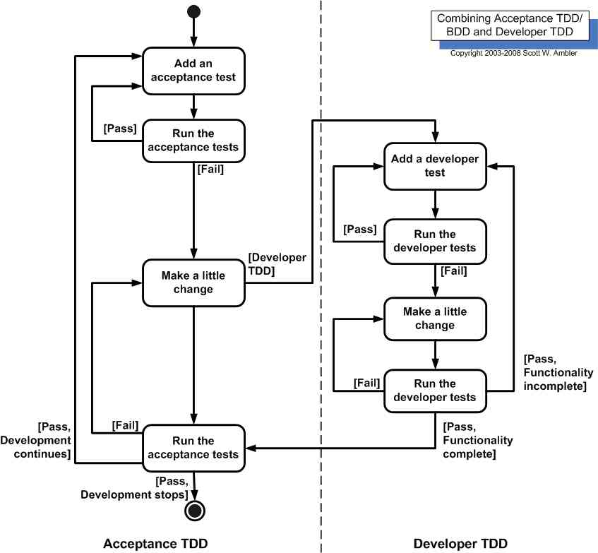
ATDD with TDD
Notes:
The point: short cycles of add a test, make it pass, clean up the code. TDD done inside the ATDD cycle. Write an ATDD for a story, which will fail for a couple days while we do TDD to make it pass.

Slide 28
Is ATDD just Regression Testing?
Regression testing is full & slow
ATDD is small, focused & fast
Notes:
ASK TRICK QUESTION: So, ATDD is better than Regression testing, right?
NO! It’s not about better. You need both.
But ATDD isn’t Regression testing. It’s both more, and less.
It’s more: gaining understanding, clarity about requirements.
It’s less: not a full regression test.

Slide 29
Acceptance Test Driven Development (ATDD) Cycle
Discuss
Distill
story
Red
Green
Clean
TDD
@Test
public void testTsd() {
int expected = Asdf.run();
assertEqual(expected,actual);
}
@Test
public void testTwo() {{
Demo (Explore)
Develop
Adapted from James Shore & Melnick, Marick, Hendrickson
Notes:
(Demo in the ATDD cycle doesn’t just mean demo as in Scrum. It means to do exploratory and other types of testing.)
NEITHER TDD NOR ATDD REPLACES ANY OF THESE OTHER KINDS OF TESTING:
Exploratory, performance, load, usability, info security, regression, break the box, etc.
Nor does it replace doing a demo to the PO or Stakeholders.

Slide 30
What’s this technique called?
Story Testing
Agile Acceptance Testing
Acceptance Test Driven Development
Behavior Driven Development
Example Driven Development
Specification By Example
Executable Specifications
Living Specifications
Specification Workshop
I’m just gathering examples to improve communication, reduce misunderstanding, clarify requirements…
Notes:
During this session I’ve called this technique ATDD and BDD and Specification by Example and maybe some other this.
What should it really be called?
Biz and Dev avoid anything with ‘Test’ in the name.
It’s not about Programming, so anything with ‘Development’ in the name is out.
Some people hate Agile and are tired of hearing about it. Also, this is useful for lean-flow kanban and in non-agile contexts. (On the other hand, if you are in an agile adoption and putting the Agile label on anything makes it easier to justify and automatically get a green light, then by all means, call it Agile Acceptance Testing.)
And no one likes meetings, so call it a ‘workshop’.
Yes, I’m just poking fun at the names here, but the point is valid… it’s not about programming or testing. It’s about understanding.

Slide 31
Test Automation - misc
Automation IS software development
Wishful Thinking
Notes:
It is programming. It’s an asset. Use good coding practices. Involve programmers in it’s development (i.e. don’t exclude testers, but do have people with significant coding skills involved). Don’t think you can get much value long term out of a record and play-back approach to test automation.
Wishful Thinking is a useful state of mind in TDD and ATDD – These are a design activity. You think of the API or the interface or the design you wish you had, write the test for that, then make the test pass.

Slide 32
Test Automation - UI
Test UNDER the UI
Only test through the UI things that really are only in the UI (ex: layout, session, workflow?)
Page Object Pattern
An object to represent a page
Hides UI details
code.google.com/p/selenium/wiki/PageObjects

Slide 33
References
@testobsessed : Elisabeth Hendrickson:
http://testobsessed.com/2011/02/the-atdd-arch/
http://testobsessed.com/wp-content/uploads/2011/04/atddexample.pdf
Bridging the Communication Gap, Gojko Adzic
Specification by Example, Gojko Adzic
If you buy the second, you can get a pdf of the 1st for free
The Cucumber Book, Wynne & Hellesøy
ATDD by Example, Gärtner
Notes:
ATDD by Example is okay, but a bit tool specific for my tastes.

Slide 34
Tools
Cucumber http://cukes.info
FitNesse http://www.fitnesse.org
SpecFlow http://www.specflow.org
JBehave http://jbehave.org
selenium.openqa.org
pyusecase / jusecase.sourceforge.net
Robot Framework http://www.robotframework.org
Concordion http://www.concordion.org
TextTest http://www.texttest.org
cubictest.com
Green Pepper greenpeppersoftware.com

Slide 35
Advanced Topics
Group specs by stability, risk
More likely to fail vs less
Run in a pipeline
The User Stories should not be visible in the specs
Notes:
You should have a Gherkin Feature spec (file) for each product feature. It should represent (specify) the current state of the system.
You can’t look at the user stories to understand the current state of any feature (unless it’s a very small one) because user stories are just a tool to guide us through the development process. They aren’t useful product documentation afterwards.
Therefore, the user stories (their IDs or titles) should now show up in the Feature files (in the specs).
Therefore, if you note fragments of gherkin in your user stories in place of acceptance criteria, those fragments should represent changes/deltas to the feature files, to your spec.

Slide 36
ATDD, BDD, Story Testing, & Specification By Example
Adding Examples to Acceptance Criteria
Andrew Fuqua
678-763-8025
andrew@leadingagile.com
@andrewmfuqua
in/andrewfuqua
Notes:
1/2015 AF@LZ

